Slide 1
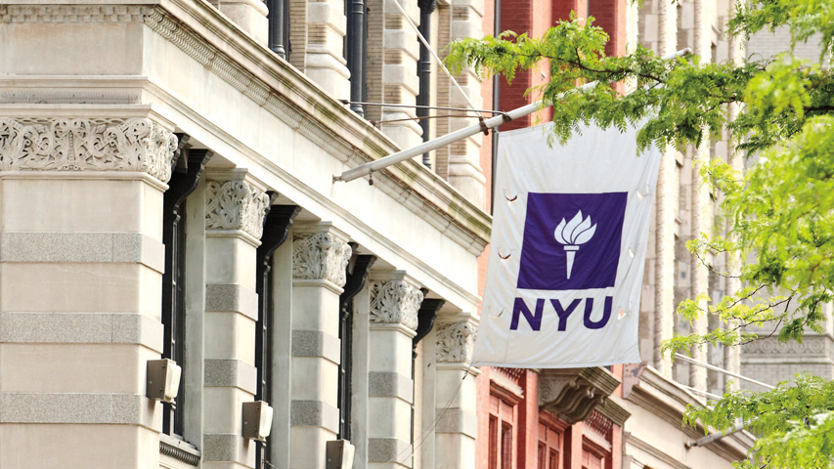

NYU Summer
Machine Learning
Program
Presenter Name Here
Date Here

Slide 2
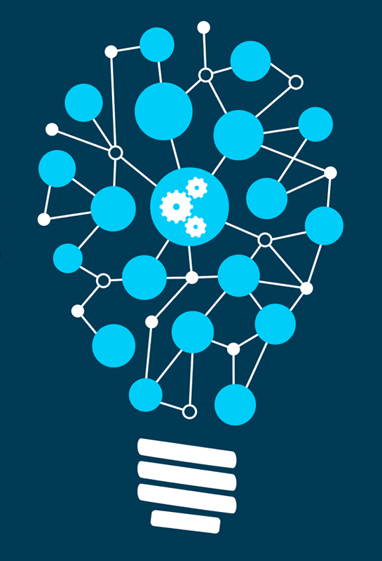
Introduction to
Machine Learning
Day 1

Slide 3
Learning Objectives
Fundamentals of Python programming language
Familiarity with NumPy and Pandas
Provide examples of Machine Learning used today
Given a new problem, qualitatively describe how a machine learning can be used
  Formulate a potential machine learning task
  Identify the data needed for the task
Classify a machine learning task
  Regression vs. Classification
Identify the predictors and target variables
Determine the role of expert knowledge in the task vs. data driven learning
05/30/19

Slide 4
Outline
Basics of Programming
  Python loops and data structures
  Scientific computational package – NumPy
  Data visualization
What is machine learning?
Types of machine learning algorithms
  Classification and regression
Why the hype today?
05/30/19

Slide 5
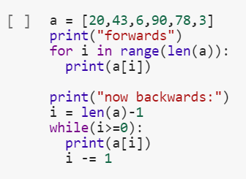
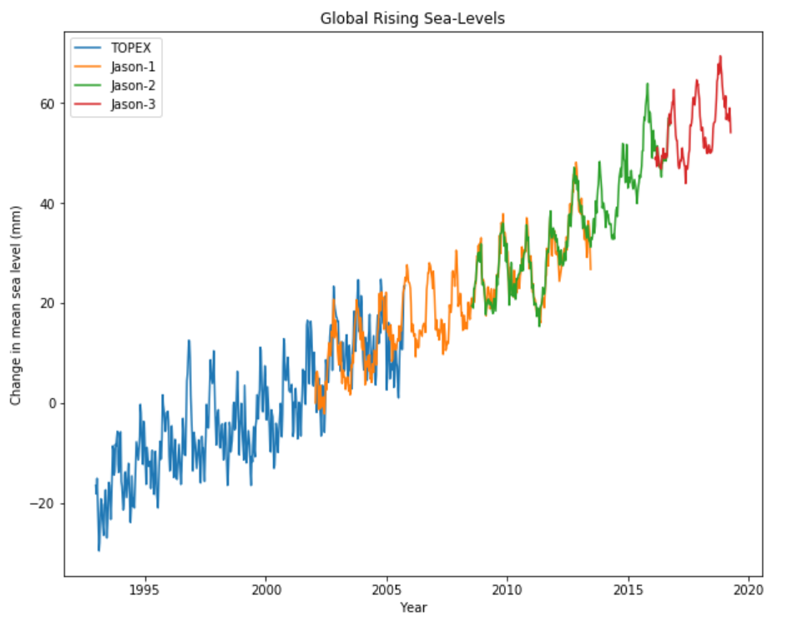
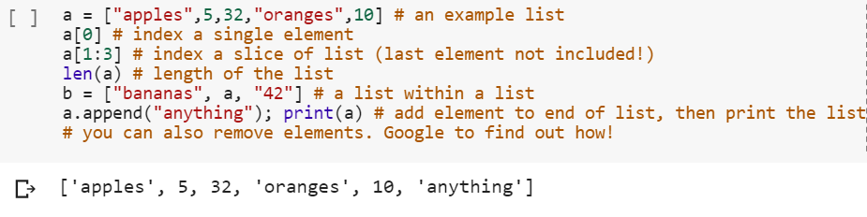
Basics of Programming
Programming basics in Google Colab Notebook
Google Colab is a free cloud service
  Machine Learning education and research tool
  Free and requires no setup
  Supports free GPU to perform fast computations
  You can improve your python programming skills
Python
  Loops
  Data Structures
Data Visualization
  Load data using Pandas
  Visualize the data by plotting histograms, scatter plots, etc.
05/30/19

Slide 6
Outline
Basics of Programming
  Python loops and data structures
  Scientific computational package – NumPy
  Data visualization
What is machine learning?
Types of machine learning algorithms
  Classification and regression
Why the hype today?
05/30/19

Slide 7
What is Machine Learning?
What is Machine Learning?
Learn the algorithm from known data to generate the rules
Make predictions on unknown data using these rules.
Data
Machine Learning
Algorithm
Rules
Answers
05/30/19

Slide 8
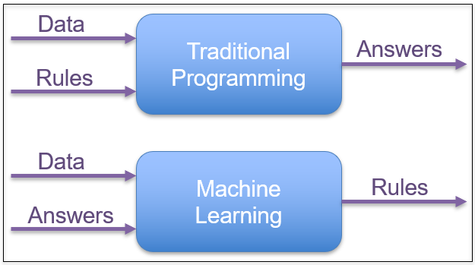
What is Machine Learning?
Why Machine Learning over Expert Approach?
Human expertise does not exist (ex: complex medical processes we don’t fully understand)
Humans are unable to explain their expertise (speech recognition)
Solution changes in time (routing on a computer network)
Solution needs to be adapted to specific cases (user biometrics)
05/30/19

Slide 9
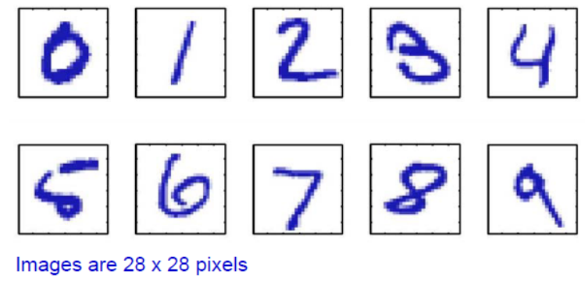
What is Machine Learning?
Example 1: Digit Recognition
Problem: Recognize a digit from the image
MNIST dataset challenge
  Dataset developed in 1990s to spur AI research on a challenging problem for the time
  Data taken from census forms
  Became a classic benchmark for machine vision problems
  We will see this dataset extensively in this class
05/30/19

Slide 10
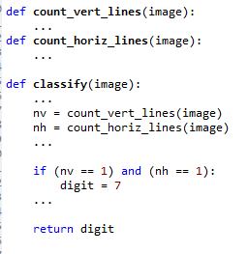
What is Machine Learning?
Example 1: Digit Recognition – Classical “Expert” Approach
Idea: Use your knowledge about digits
  You are an “expert” since you can do the task
  So, you construct simple rules and code them
Expert rule example: “Image is a digit 7 if…”:
  There is a single horizontal line, and
  There is a single vertical line
Rule seems simple and reasonable
But,…
05/30/19

Slide 11

What is Machine Learning?
Example 1: Digit Recognition – Problems with Expert Rules
Simple expert rule breaks down in practice
  Hard to define a “line” precisely
  Orientation, length, thickness, …
  May be multiple lines…
General problem: Difficult to code our knowledge
  We can do the task
  But it is hard to translate to simple mathematical formula
05/30/19

Slide 12
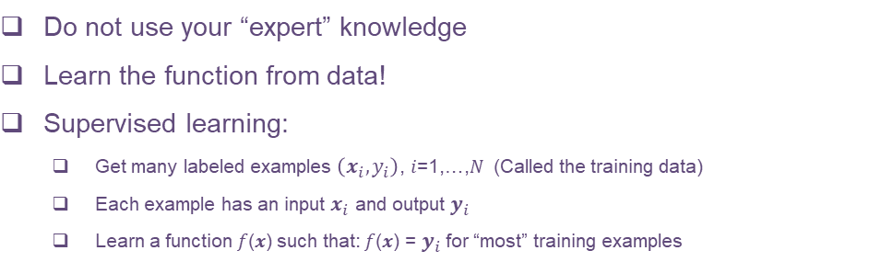
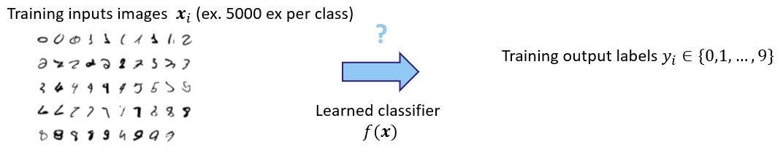
What is Machine Learning?
Example 1: Digit Recognition – Problems with Expert Rules
05/30/19

Slide 13
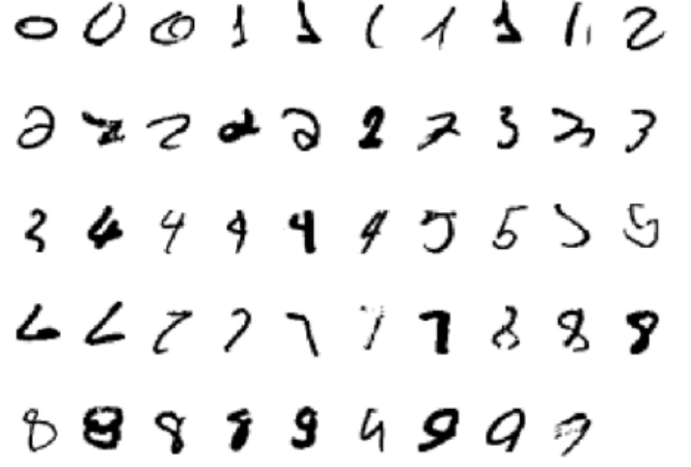
What is Machine Learning?
Example 1: Digit Recognition – ML Approach Benefits & Challenges
Learned systems do very well on image recognition problems
  On MNIST, current systems get <0.21% errors (as of 1/20/2018)
  Used widely in commercial systems today (e.g. OCR)
  Cannot match this performance with an expert system
But there are challenges:
  How do we acquire data? Someone must manually label examples.
  How do we train an algorithm to learn from the data?
  If a function works on training example, will it generalize on new data?
This is what you will learn in this course
05/30/19

Slide 14
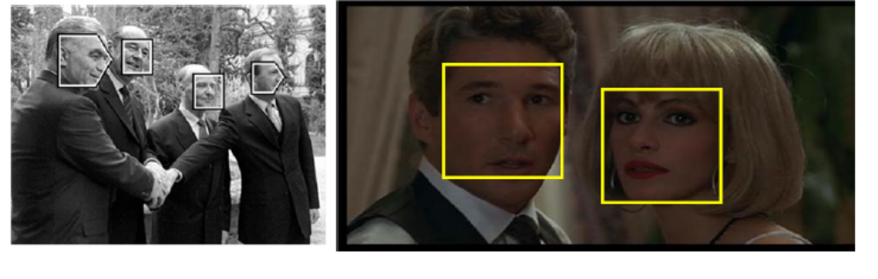
What is Machine Learning?
Example 2: Face Detection
Problem: For each image region, determine if face or non-face
More challenging than digit recognition
  Even harder to describe a face via “rules” in a robust way
05/30/19

Slide 15
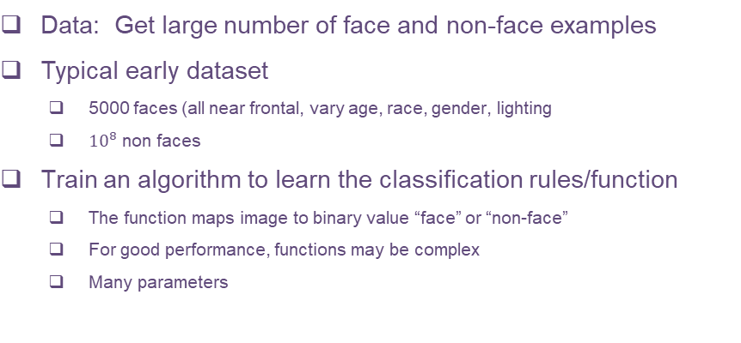
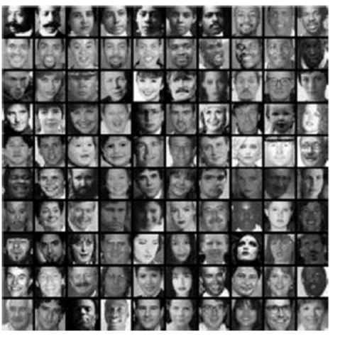
What is Machine Learning?
Example 2: Face Detection - Supervised Learning Approach
05/30/19

Slide 16
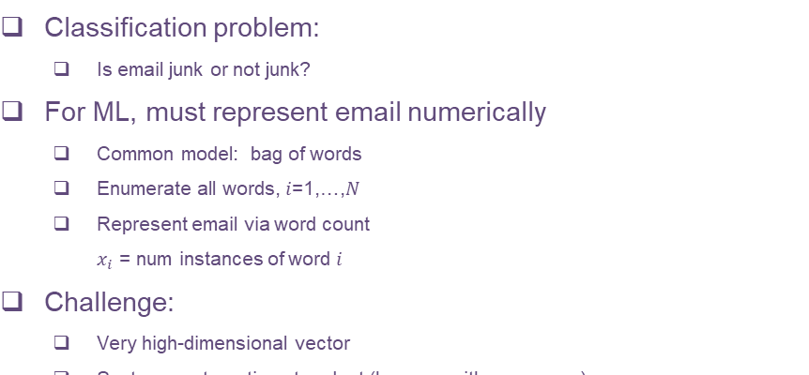
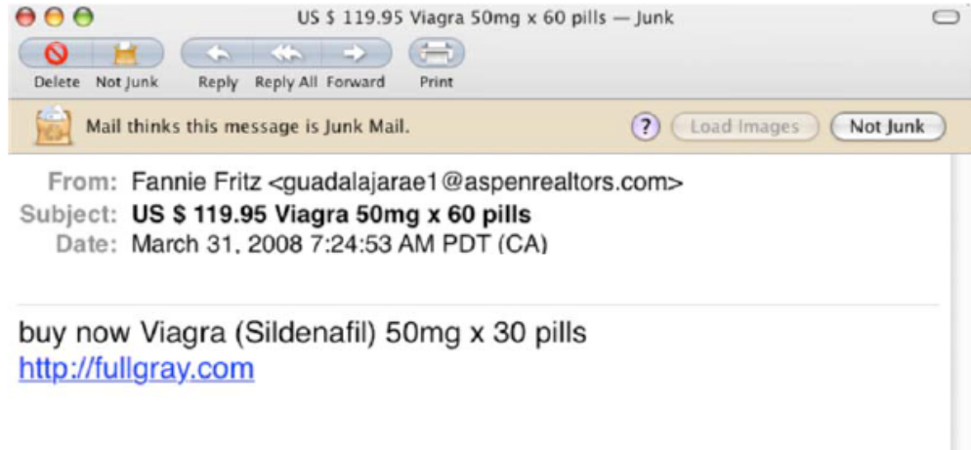
What is Machine Learning?
Example 3: Spam Detection
05/30/19

Slide 17
What is Machine Learning?
Machine Learning in Many Fields
Retail: Market basket analysis, Customer relationship management (CRM)
Finance: Credit scoring, fraud detection
Manufacturing: Control, robotics, troubleshooting
Medicine: Medical diagnosis
Telecommunications: Spam filters, intrusion detection
Bioinformatics: Motifs, alignment
Web mining: Search engines
05/30/19

Slide 18
Outline
Basics of Programming
  Python loops and data structures
  Scientific computational package – NumPy
  Data visualization
What is machine learning?
Types of machine learning algorithms
  Classification and regression
Why the hype today?
05/30/19

Slide 19
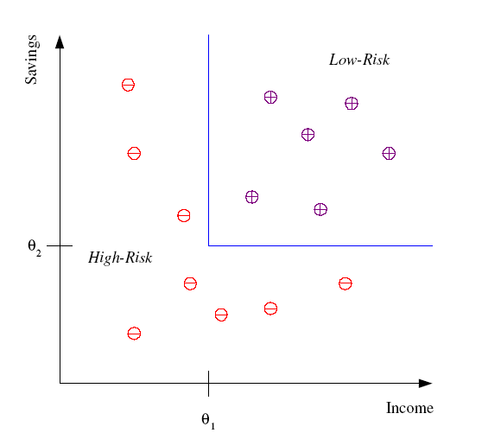
Machine Learning Algorithms
Classification
Example: Credit score
Determine if customer is high-risk or low-risk
Select features:
  Example: Income & Savings
  Represent as a vector 𝑥=(𝑥_1,𝑥_2)
Learn a function from features to target
  Use past training data
Need to get this data
05/30/19

Slide 20
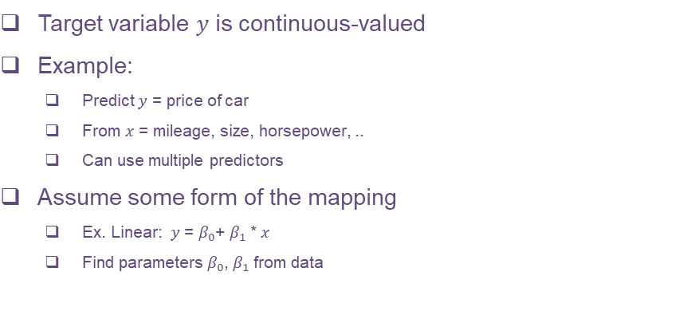
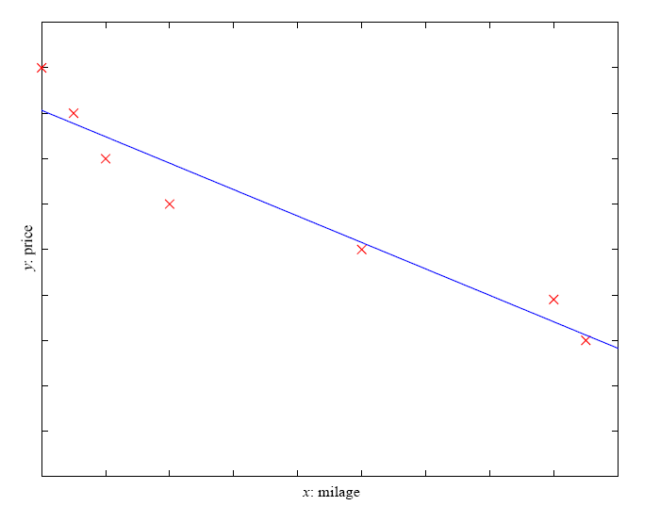
Machine Learning Algorithms
Regression
05/30/19

Slide 21
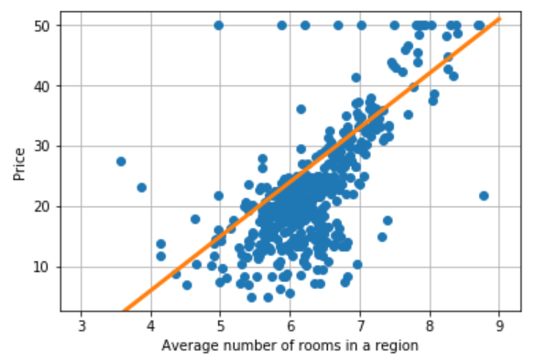
Machine Learning Algorithms
Regression Example – In Google Colab Notebook
The Boston housing data set was collected in the 1970s
Predict housing prices
Many possible predictors:
  Crime
  Areas of non-retail business in the town
  Age of people who own the house
05/30/19

Slide 22
Outline
Basics of Programming
  Python loops and data structures
  Scientific computational package – NumPy
  Data visualization
What is machine learning?
Types of machine learning algorithms
  Classification and regression
Why the hype today?
05/30/19

Slide 23
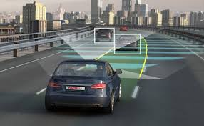
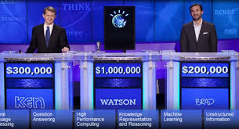
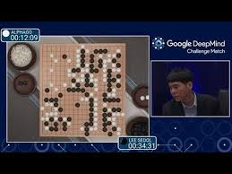
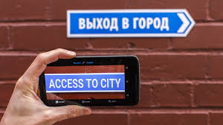
Why the hype today?
What ML is Doing Today?
Autonomous driving
Jeopardy
Very difficult games: Alpha Go
Machine translation
Many, many others…
05/30/19

Slide 24
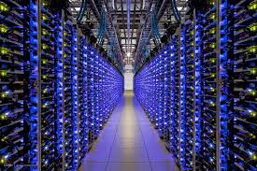
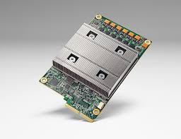
Why the hype today?
Why Now?
Machine learning is an old field
  Much of the pioneering statistical work dates to the 1950s
So what is new now?
Big Data:
  Massive storage. Large data centers
  Massive connectivity
  Sources of data from Internet and elsewhere
Computational advances
  Distributed machines, clusters
  GPUs and hardware
05/30/19

Slide 25
Summary
Fundamentals of Python programming language
Familiarity with NumPy and Pandas
Provide examples of Machine Learning used today
Given a new problem, qualitatively describe how a machine learning can be used
  Formulate a potential machine learning task
  Identify the data needed for the task
Classify a machine learning task
  Regression vs. Classification
Identify the predictors and target variables
Determine the role of expert knowledge in the task vs. data driven learning
05/30/19

Slide 26
Why the hype today?
Thank You!
05/30/19

